Slide 1
Mini Project – MusiRelm ( Music Player Website )
1) Submitted By – Kulkarni Sarthak Sanjay
2) College id – 2330047
3) Submitted to – Prof. Yogesh kangale

Slide 2
Overview
CHAPTER 1 : INTRODUCTION
CHAPTER 2 : PROPOSED SYSTEM
CHAPTER 3 : SYSTEM DESIGN
CHAPTER 4: USER INTERFACE
CHAPTER 5 : FUTURE ENHANCEMENTS
CHAPTER 6 : CONCLUSION
CHAPTER 7 : BIBLIOGRAPHY
CHAPTER 8 : ANNEXURE

Slide 3
CHAPTER 1 : INTRODUCTION
Welcome to our Music Player Website, a simple and intuitive platform designed to bring your favourite tunes to life!
This project is/was created as part of a college project, this web application allows you to easily browse, play, and enjoy your music collection all in one place.
Whether you're at home, on campus, or anywhere in between, our goal is to offer you a seamless music experience with features like play, pause, volume control. Dive into the world of music, and let the beats flow!

Slide 4
CHAPTER 2 : PROPOSED SYSTEM :
1. SCOPE OF EXISTING SYSTEM :
Music Streaming : The only service that this website is aiming to provide is for users to listen to music.
Music Discovery : Allowing visitors to explore a genuine library of tons of music albums and discover new music, artists and evolving their music taste along the way.
Multi-Platform Compatibility : The website should be able to run on multiple browsers and devices providing a on-the go remote accessibility

Slide 5
2. LIMITATIONS OF EXISTING SYSTEM :
Limited Accessibility : Older technology could have some constraints regarding running the website since it might not support the version of the older devices.
Geographical Restrictions : Some services might be unavailable in certain regions due to legal or licensing issues.
Storage Constraints : Downloading and storing music files can be hard since they consume storage and might require a larger storage for any server for able to store them.

Slide 6
Objectives
1. Build a Functional Music Player:
Develop a music player interface that allows users to play, pause, skip, and shuffle tracks seamlessly.
Include options for volume control, progress tracking, and repeat mode.
2. User Authentication and Account Management:
Enable users to create an account, log in, and manage their profiles. Allow users to save their favorite tracks and create custom playlists.

Slide 7
Objectives
3. Playlist Creation and Management:
Allow users to create, edit, and delete playlists.
Enable users to add, remove, or reorder songs within their playlists.
4. Search and Filtering Features:
Provide a search feature for users to search tracks by name, artist, album, or genre.
Implement filtering options for organizing music based on metadata.

Slide 8
Objectives
5. Responsive and Cross-Platform Design:
Ensure the website is responsive, with a smooth experience on desktops, tablets, and mobile devices.
Optimize for a variety of screen sizes and devices to enhance user accessibility.
6. Efficient Music Streaming:
Integrate a method for music streaming that minimizes buffering and maximizes audio quality.
Provide options to select music quality based on user preferences.

Slide 9
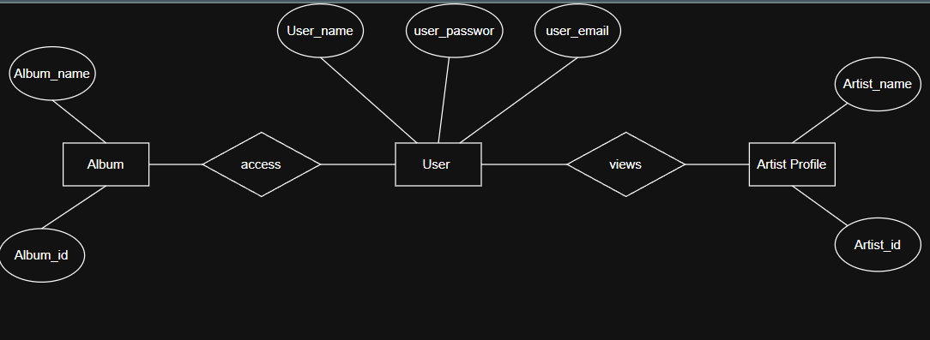
CHAPTER 3 : SYSTEM DESIGN
ERD Diagram LEVEL - 1

Slide 10
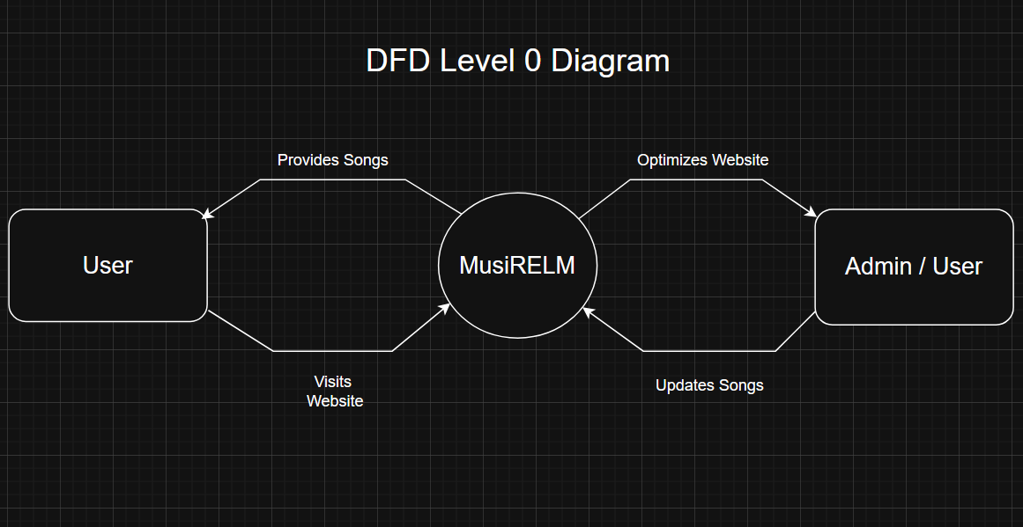
CHAPTER 3 : SYSTEM DESIGN
DFD Diagram LEVEL - 0

Slide 11
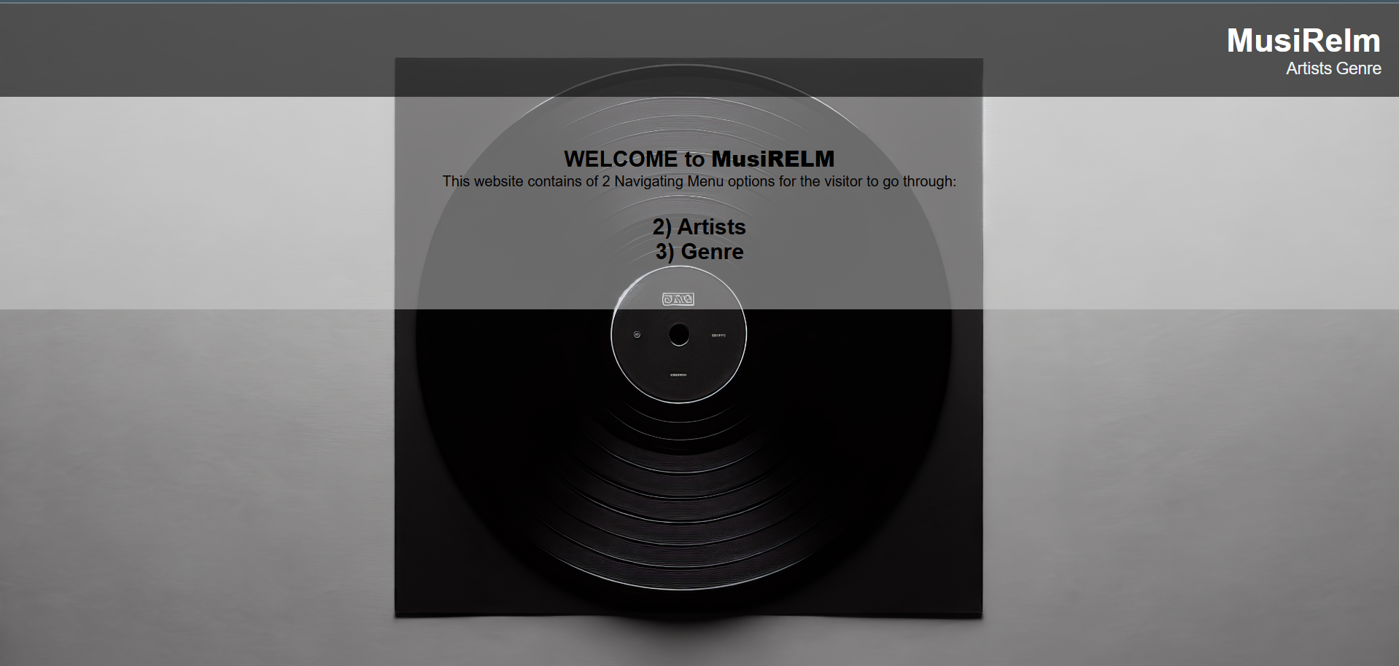
CHAPTER 4 : USER INTERFACE Images of Web Interface

Slide 12
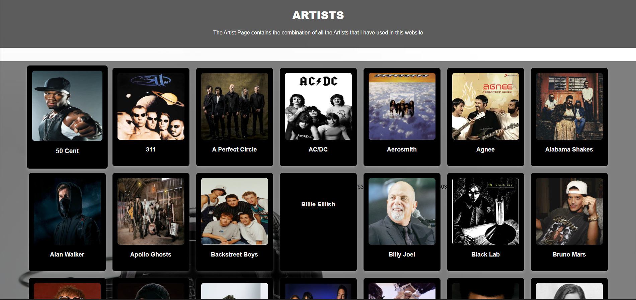
CHAPTER 4 : USER INTERFACE Images of Web Interface

Slide 13
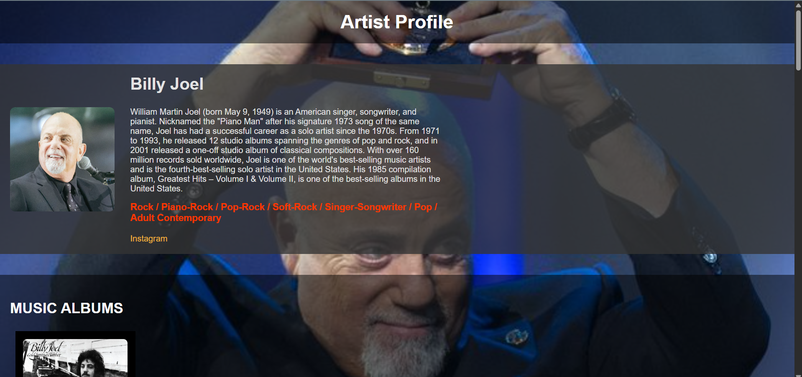
CHAPTER 4 : USER INTERFACE Images of Web Interface

Slide 14
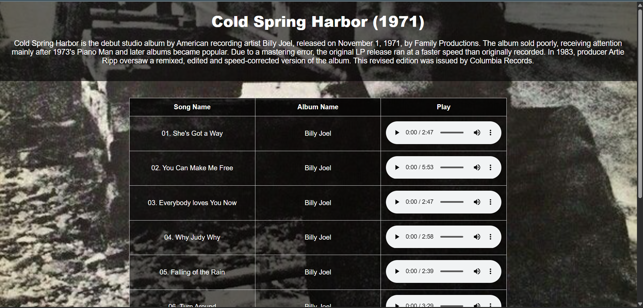
CHAPTER 4 : USER INTERFACE Images of Web Interface

Slide 15
CHAPTER 5 : FUTURE ENHANCEMENTS
1. UI/UX Improvements:
Enhanced navigation – adding a Music Navigation Bar
Better responsive design for mobile/tablets
Adding dark mode or theme customization
2. Smart Personalization:
AI-Powered Recommendations – Suggest music based on user preferences.
Smart Playlists – Auto-generate playlists based on mood, genre, or activity.
Lyrics Display – Show synchronized lyrics while the song plays.

Slide 16
CHAPTER 5 : FUTURE ENHANCEMENTS
3. Integration & Compatibility :
Smart Device Support – Work with smart speakers (Alexa, Google Home).
Mobile App Integration – Sync progress between web & mobile app.
API Integration – Support third-party apps or external music libraries.
4. User Engagement & Social Features:
User Profiles & Playlists – Let users create & share playlists.
Comment & Like System – Allow users to interact with songs.
Real-time Listening Parties – Sync music playback with friends.

Slide 17

CHAPTER 5 : FUTURE ENHANCEMENTS
5. Performance & Security
Faster Load Times – Optimize audio streaming for better performance.
End-to-End Encryption – Secure user data and playback history.

Slide 18
CHAPTER 6 : CONCLUSION
MusiRelm is a Music Player website that lets users access all the music related content according to their music tastes.
MusiRelm provides a rich collection of Music Albums that users can explore and enjoy listening to.
Since this mini project is just a static representation of the website that is going to be eventually progressing in terms of development, there is limited amount of genres and artist selected for displaying and listening.
There are limited features in the project since it is for only Demonstration purpose and has extremely easy navigation

Slide 19
CHAPTER 7 : BIBLIOGRAPHY
https://open.spotify.com/?flow_ctx=5c6af8d3-582e-44fa-b5b7-99f0bd844190%3A1743673974#login
https://music.apple.com/us/new
https://music.youtube.com/

Slide 20
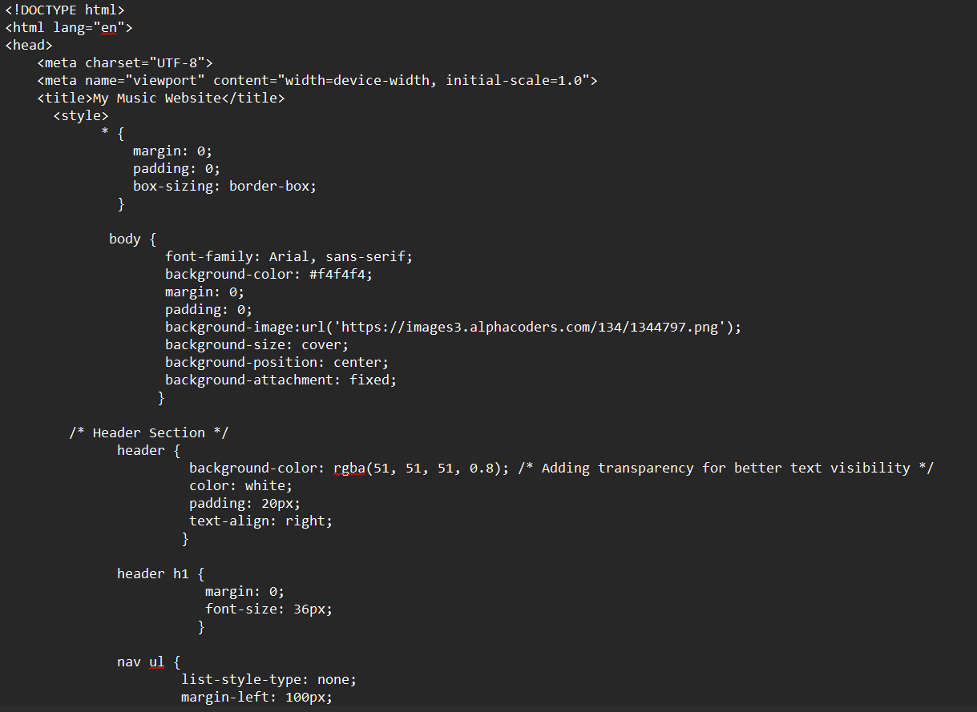
CHAPTER 8 : ANNEXURE
Home Page

Slide 21
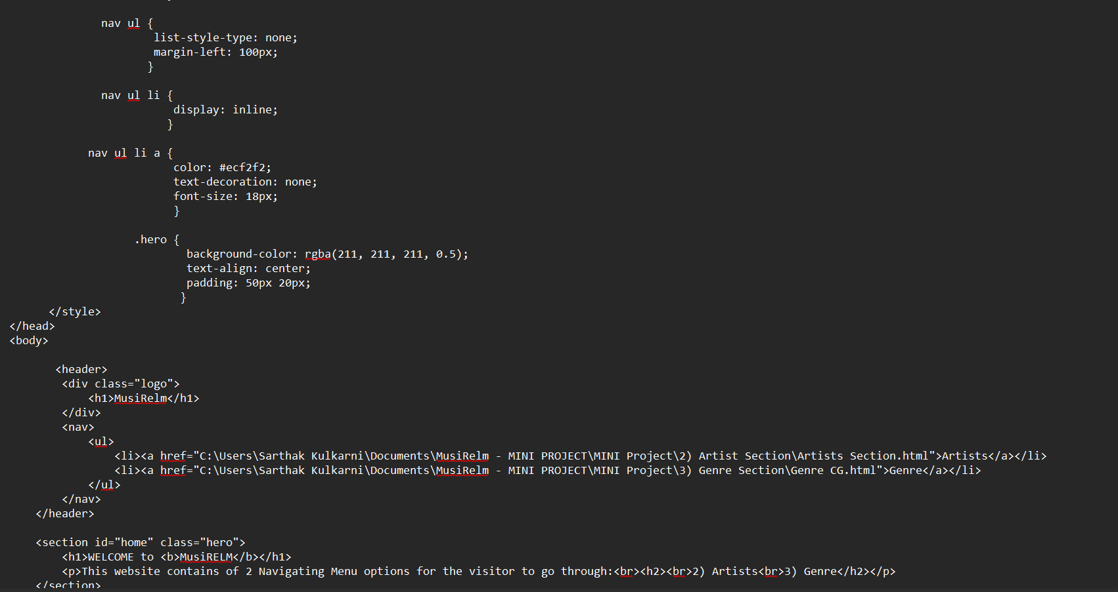
CHAPTER 8 : ANNEXURE

Slide 22
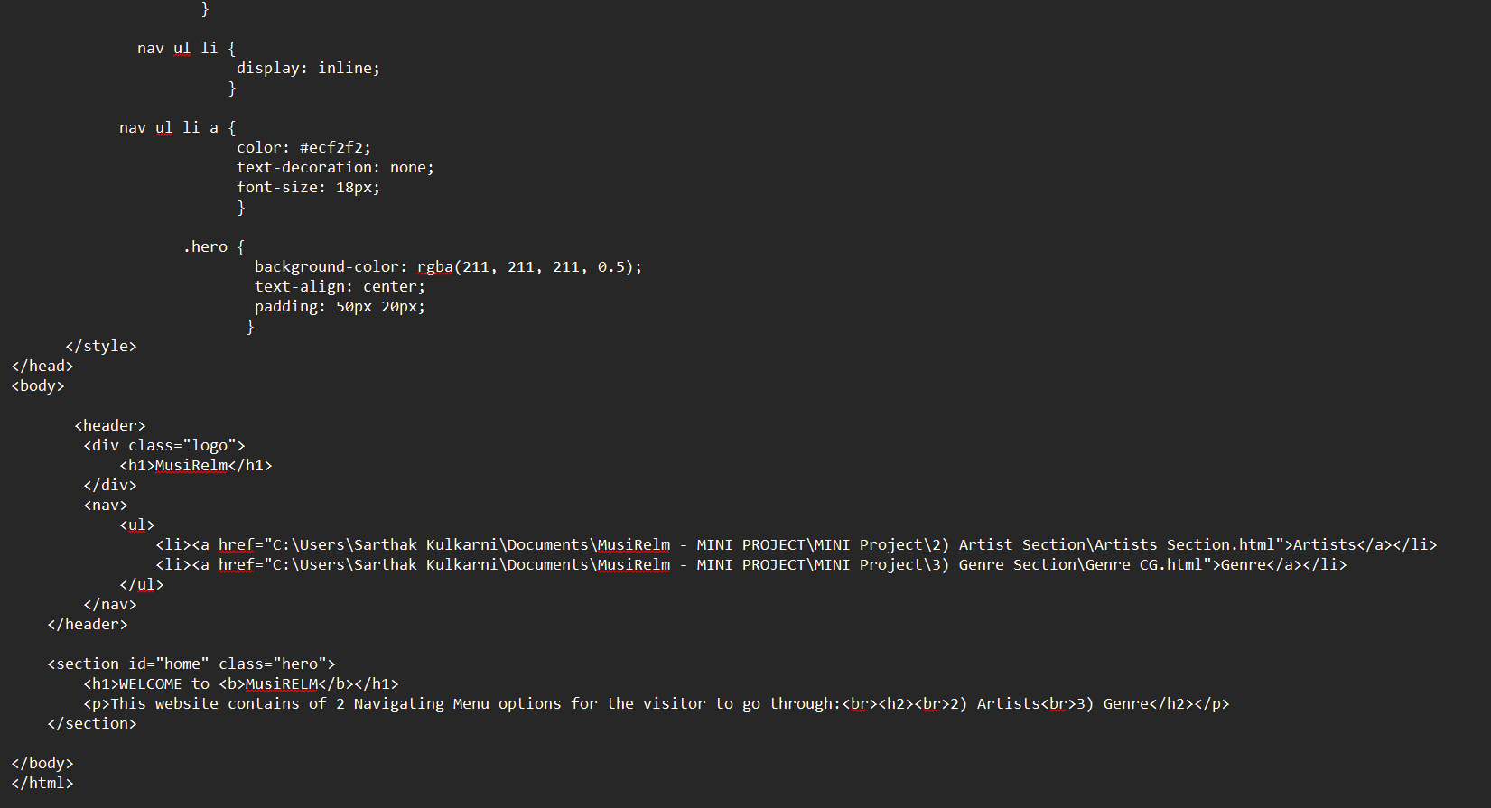
CHAPTER 8 : ANNEXURE

Slide 23
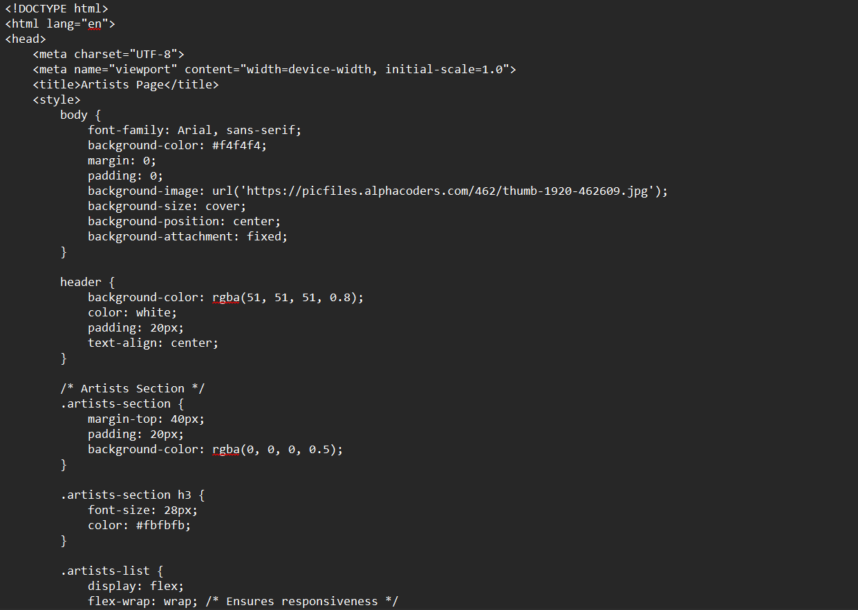
CHAPTER 8 : ANNEXURE
Artist Webpage

Slide 24
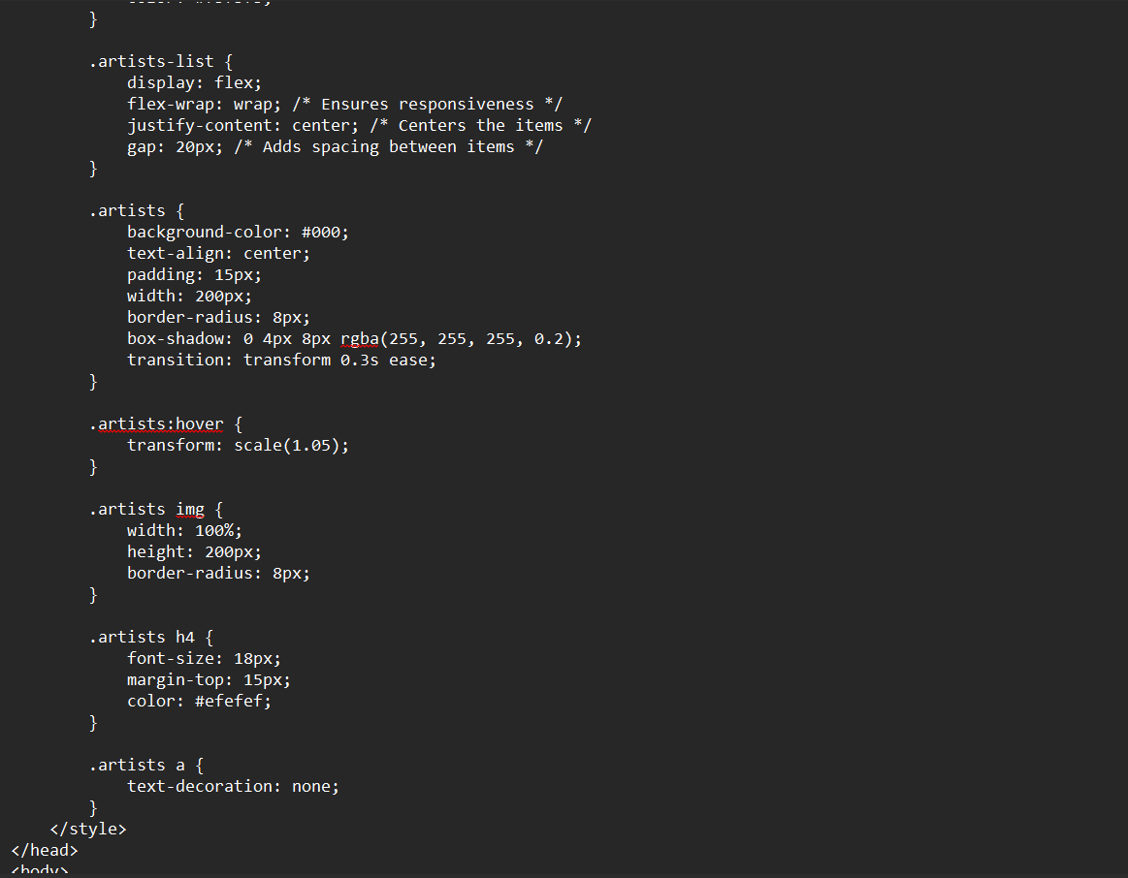
CHAPTER 8 : ANNEXURE

Slide 25
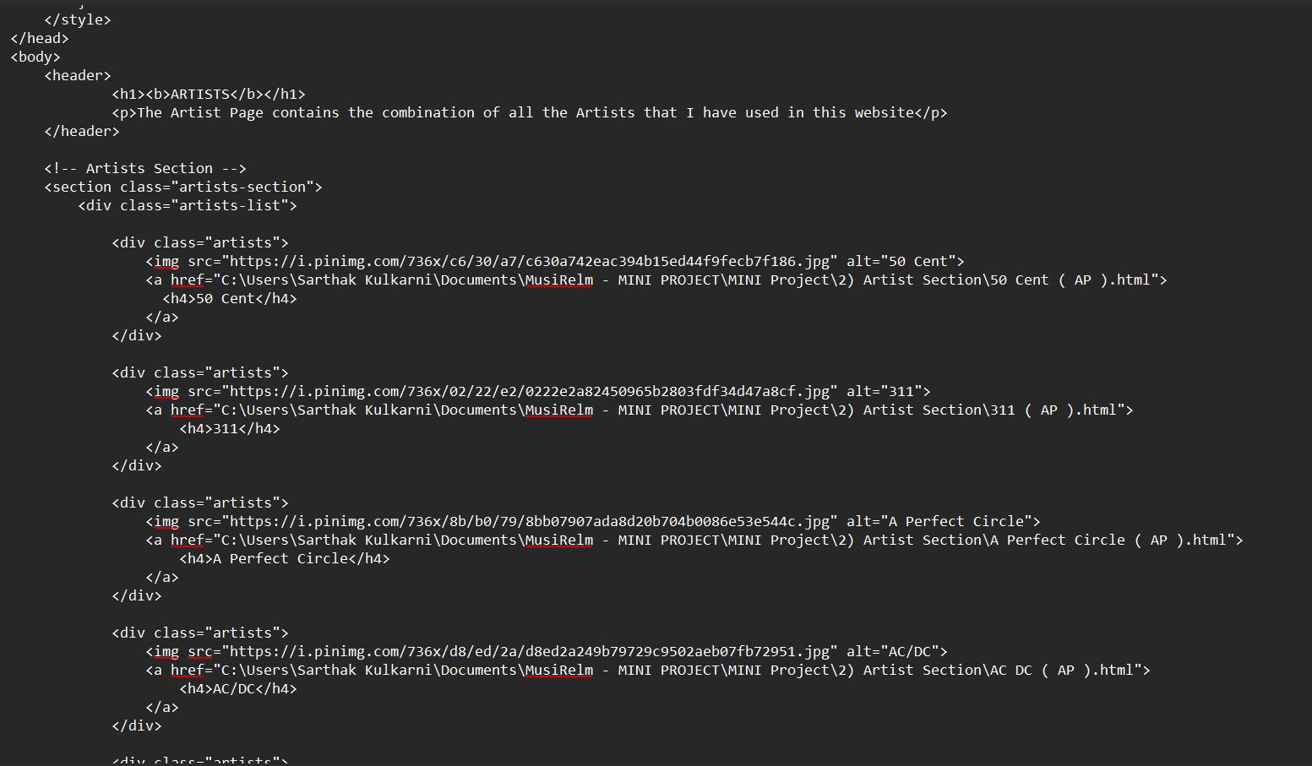
CHAPTER 8 : ANNEXURE

Slide 26
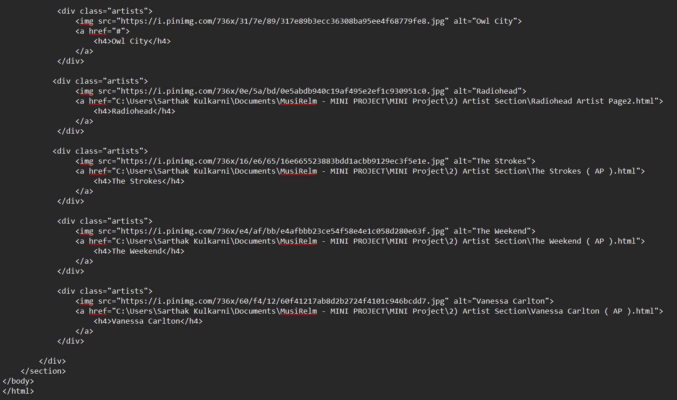
CHAPTER 8 : ANNEXURE

Slide 27
THANK YOU

